Slide 2

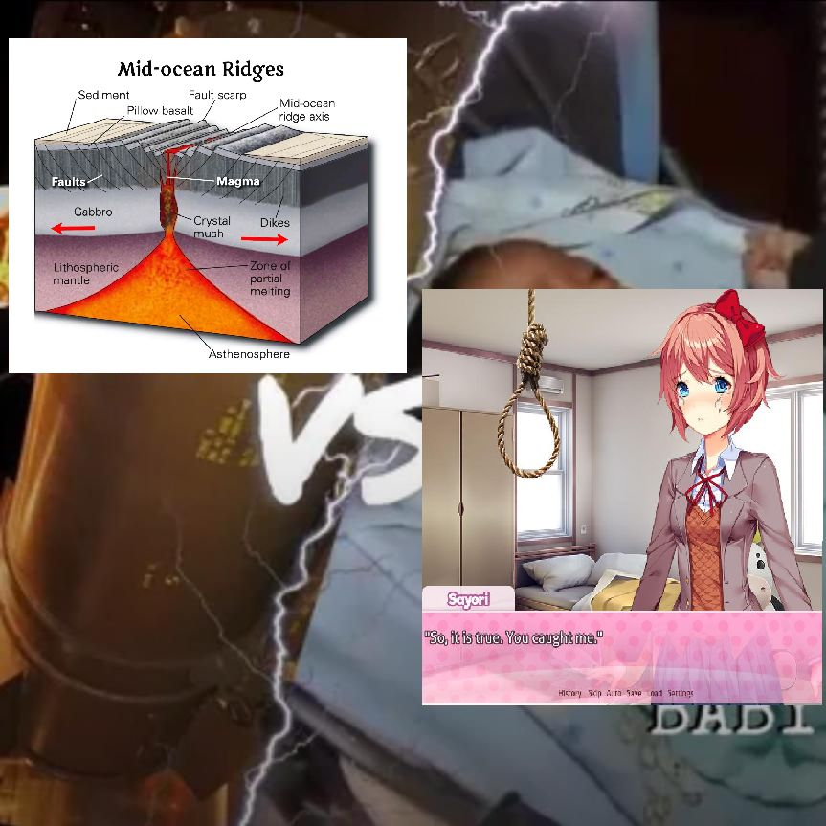
Topic 4: Regularization – Ridge vs. Lasso
RIDGE
LASSO
Presented by John Benedict M Hornilla

Slide 3



Agenda For Today:
What is Ridge Regression?
What is Lasso Regression?
Ridge VS Lasso Regression
How It’s Made Works
Real-World Applications, Studies, and Research Utilizing Ridge and Lasso Regression

Slide 4

What is Ridge Regression?
It is a statistical regularization technique that corrects overfitted training data on machine learning models.
Also known as L2 Regularization, it reduces errors by correcting multicollinear variables on regression analysis.
Notes:
Regularization: is a statistical method to reduce errors caused by overfitting on training data
Multicollinearity: more than two variables are correlated. “Which will be discussed on the later on”
What is overfitting you may ask? It’s a situation where the predictive model fits too closely to the training data resulting in inaccurate prediction when given any data other than the training data. This is a huge problem in machine learning as we want our model to still generate accurate predictions even when introduced to brand new data.
This regression method forces the model to keep coefficients small. By keeping the coefficients close to zero, it simplifies the model and reduces its sensitivity to random noise in the data. This makes the model less likely to overfit and helps it perform better on new, unseen data, improving its overall accuracy and reliability.
The following slides are formulas that are used in regularization techniques.

Slide 5
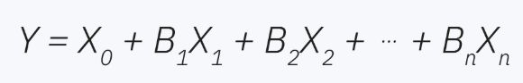
What is Ridge Regression?
An example of a standard multi-variable linear regression:
Y = dependent variable
X = independent variable
B = regression coefficient (Penalty term)
X₀ = value of Y when X is zero
Notes:
B = regression coefficient attached to a given independent variable

Slide 6
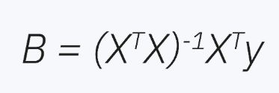
What is Ridge Regression?
When developing prediction models, we must estimate the coefficients as they are not explicitly stated in the training data. Thus, we can use a standard Ordinary Least Squares (OLS) matrix coefficient estimator:
Notes:
This formula aims to find the best fitting line for a given dataset by calculating coefficients for each independent variable that collectively result in the smallest residual sum of squares.

Slide 7
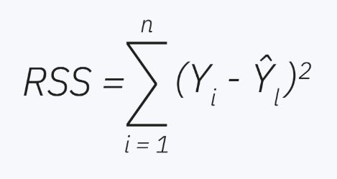
What is Ridge Regression?
Residual Sum of Squared (RSS), measures how well a linear regression model accurately matches the training data. It is represented by the following formula:
Notes:
The formula measures model prediction accuracy for ground-truth values in the training data. If RSS = 0, then the model perfectly predicts the dependent variables. However, having a score of zero is not always the best case scenario as it may be a sign of overfitting on the training data and multicollinearity may be the cause of the overfitting.

Slide 8
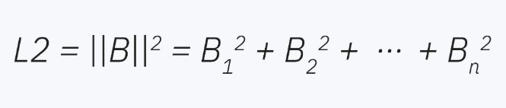
What is Ridge Regression?
Ridge Regression corrects high-value coefficients by introducing a penalty into the RSS function.
Notes:
The penalty is the sum of the squares of the model’s coefficient

Slide 9
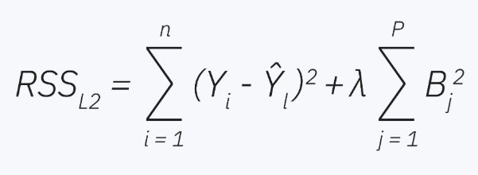
What is Ridge Regression?
The penalty is inserted at the end of the RSS function. Its effect on the model is controlled by the hyperparameter lambda
Notes:
What is hyperparameter lambda, it’s a perimeter that dictates the strength of regularization.
Remember that coefficients mark a given predictor’s effect on the predicted value. Once added, the penalty counteracts high coefficients by reducing all coefficient values, also called as coefficient shrinkage. This minimizes every predictor’s effect and reduces overfitting on training data.
Furthermore, note that ridge regression does not shrink every coefficient by the same value but rather based on their initial size and that ridge regression does not reduce a coefficients number to absolute zero.
With that discussed, we will be moving forward to the lasso regression.

Slide 10
What is Lasso Regression?
It is a statistical regularization technique that corrects overfitted training data on machine learning models, similar to Ridge Regression.
Stands for Least Absolute Shrinkage and Selection Operator, also called as L1 Regularization, is frequently used to handle high dimensional data as it facilitate automatic feature selection.
Notes:
High dimensional data – is considered when the number of independent variables are much larger than the dependent variables. Lasso regression can help reduce dimensionality by shrinking the coefficients to zero.
Automatic feature selection – automatically shrinks the coefficients toward zero leaving the model with only the most important variables to make predictions

Slide 11
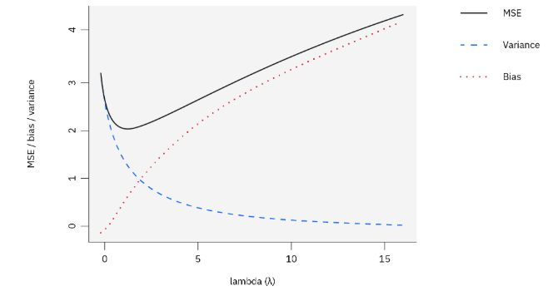
What is Lasso Regression?
Bias-Variance Tradeoff Graph:
Y = dependent variable
X = independent variable
B = regression coefficient
X₀ = value of Y when X is zero
Tip:
Zero lambda = no regularization
Notes:
What is a Bias-Variance Tradeoff? It’s a principle or concept that trades between high variance with low bias, and low variance with high bias. Wherein as bias increases, the model predicts less accurately on a given dataset while, as variance increases, the model predicts less accurately on other datasets. Like if the predictive model is overfitted on the given dataset, upon testing it on other datasets, it will predict the outcome less accurately compared to the original dataset it was trained on.
X axis – regularization strength
Y axis – error terms
Blue – measures the model’s prediction if trained on different dataset. High variance means model is too sensitive. Higher lambda = more stable model
Red – Bias, it measures the difference between the predicted and true values. Higher lambda, coefficient shrink too much, bias grows
Black – Mean squared error, it measures how far the predictions are compared to the true values. Zero lambda, where variance is high, the mse is also high, at high lambda, coefficient shrink in turn model has high bias, the mse is also high, but on moderate lambda, the MSE reaches its lowest point and is the most optimal lambda for the regression.

Slide 12
What is Lasso Regression?
Before applying a linear regression algorithm to your dataset, we must explore and analyze our present data and check for any potential underlying issues like; Is there any missing data?, Is there a high number of features?, or Is there any independent variables that are correlated to one another?
These are important to consider as to prevent any overfitting for the prediction model.
Notes:
After analyzing our data, we’ll spit the data into training set and test set, after splitting the data, we apply rescaling to the data. Z-score scaling is a common scaling approach which rescales features to share a standard deviation of 1 and a mean of zero.

Slide 13
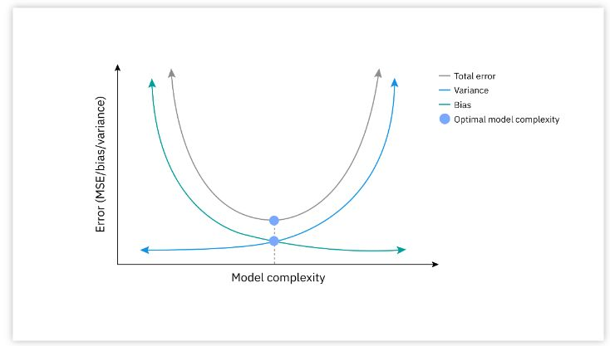
What is Lasso Regression?
Fit the lasso regression model on the training data and choose a value for lambda with the objective of minimizing the mean squared error.
Notes:
Mean squared error is used to measure the difference between predicted and true values of the dependent variable
After fitting the model, we can optimize the lambda value with cross validation techniques. As noted earlier, high lambda value is equal to more regularization, and results with higher bias while variance decreases. This is because as lambda increases more coefficients shrink to zero.

Slide 14
What is Lasso Regression?
Common uses for lasso regression is for handling high-dimensional data by eliminating less important features from the model and Automatic feature selection in which the bias introduced by the L1 penalty will shrink the coefficients toward zero.
Notes:
This way, it leaves the model with a subset of only the most important variables to make prediction
With both regularization techniques discussed, lets compare both to each other

Slide 15

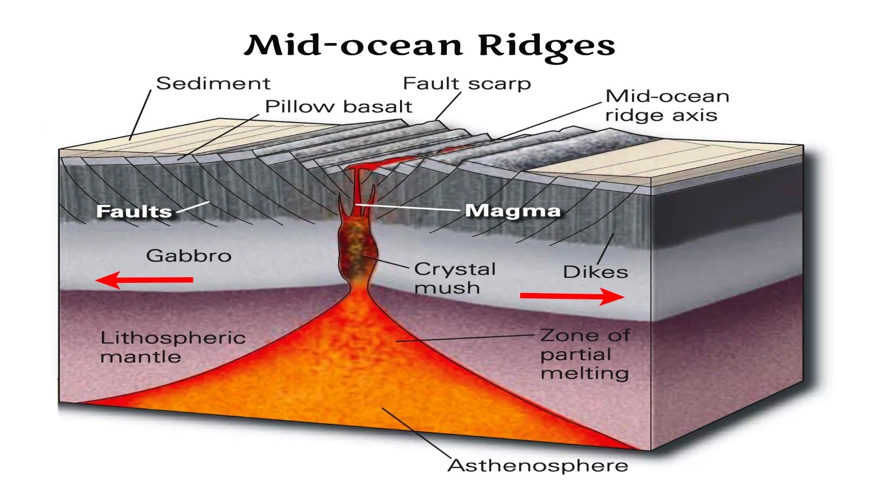


Quote
Notes:
We will be comparing each technique and discuss their pros and cons

Slide 16
Ridge VS Lasso Regression
Ridge Regression:
L2 penalty does not shrink coefficients towards absolute zero
Does not perform feature selection
In Bias-Variance Tradeoff, ridge does not drop variables
Best when most features are correlated
Lasso Regression:
L1 penalty shrinks coefficients to zero
Does perform feature selection
In Bias-Variance Tradeoff, lasso drops entire variables
Best when only a few features matter
Notes:
Both Regularization techniques are best to use for reducing overfitting on a predictive model, but each one has their own specialty.
Ridge regression is best for handling severe multicollinearity as it reduces the coefficients based on their value
Lasso regression can handle some level of multicollinearity, but it cannot handle severe multicollinearity, thus is best when you need the model to use only the beneficial data from the dataset.
Now we know about both ridge and lasso regression, ill be showing you diagrams and sample codes for each technique.

Slide 17

Quote
How it works: Ridge and Lasso Regression
Notes:
Queue How it works ridge and lasso regression

Slide 18
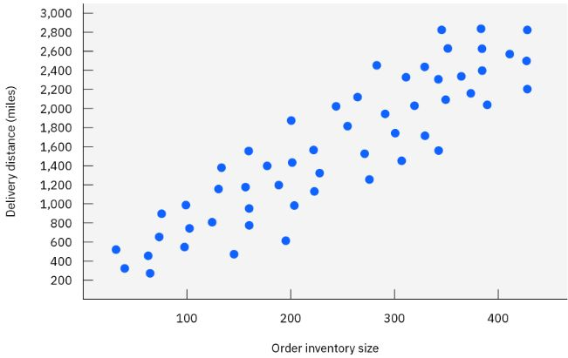
Quote
How it works: Ridge Regression
Problem:
As a logistics officer – we analyze a supply chain dataset wherein long-distance deliveries must contain high amounts of packages while, short distance deliveries must contain smaller amounts of packages.
Notes:
Alternative: packages per mile
Possible solutions: add more unique variables, like package weight/volume, delivery time, fuel cost per trip, road or weather conditions, or type of shipment.
In that way we can form a more diverse regression analysis model than what we had from the start.

Slide 19
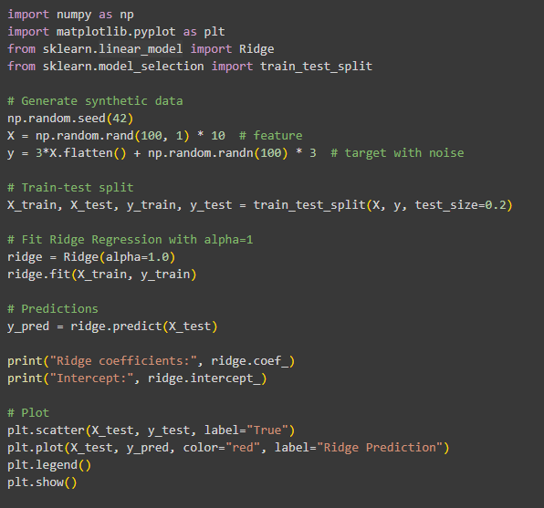
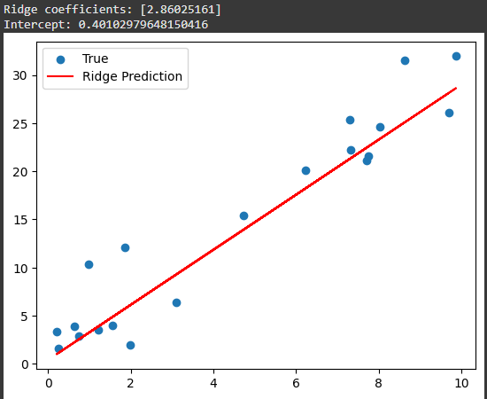
Quote
How it works: Ridge Regression
Source: ChatGPT
Notes:
#generate
Np.random.seed(42) – ensures reproducibility for each code execution, remove 42 for true randomness
Np.randon.randn – generates x value between 0-10
*3 – adds noise, extra random data
Alpha = penalty
Ridge.coeff – slope shrunken by penalty – it tells how much y changes when x increases by 1
Ridge.intercept – y-intercept – is the value of y when x is 0
Plt.scatter – plots the actual data points
Plt.plot – draws the prediction
So, if you may be wondering, why are the Data points not in line of the red line? It’s because of the added noise
To reflect realistic datasets and a great test for regression models.
Then we have the lasso regression

Slide 20
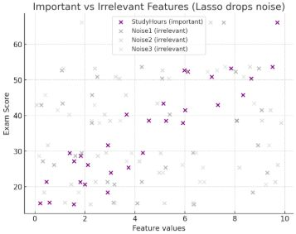
Quote
How it works: Lasso Regression
Problem:
Suppose that we are predicting a student’s exam scores based on 5 different features, composed of Study hours, and three random variables that cannot affect a student’s exam score like, Valo rank, physical height, and gender.
Notes:
With using lasso regression, the L1 penalty shrinks irrelevant coefficients to absolute zero, which is a function of automatic feature selection, so that only the important variable which is study hours, is used to predict the student’s score.

Slide 21
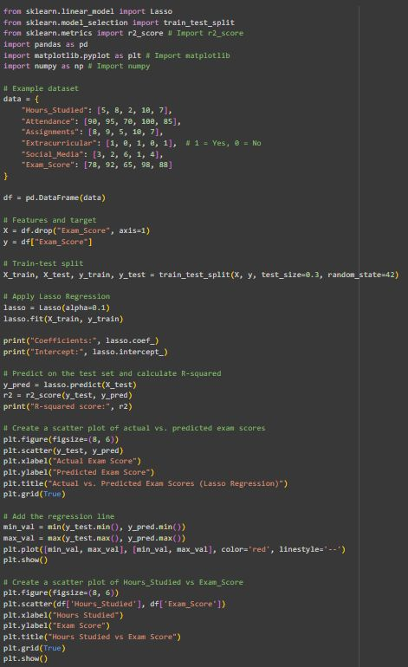
Quote
How it works: Lasso Regression
Source: ChatGPT + gemini
Notes:
This is a code snippet from chatgpt and a few modifications by gemini in google colab.
R-squared score is a statistical measure that represents the proportion of the variance in the dependent variable, which in this case is the exam score, that is predictable from the independent variables. An r-squared score of 1 means the model perfectly predicts the dependent variable while an r-squared score of 0 means the model is inaccurate in predicting the dependent variable.

Slide 22
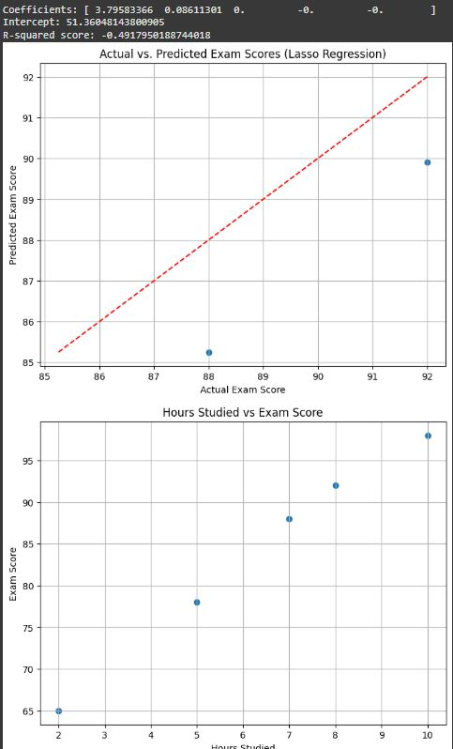
Quote
How it works: Lasso Regression
Source: ChatGPT + gemini
Notes:
As you can see the r-squared score is negative zero, which unfortunately happens with using a small dataset as we only used 4 independent variables and 1 dependent variables.
Now we will be moving forward to the real world applications, studies, and research utilizing ridge and lasso regression,

Slide 23

Quote
Real-World
Applications, Studies, and Research Utilizing Ridge and Lasso Regression

Slide 24

Ridge regression and its applications in genetic studies
Arashi, M., Roozbeh, M., Hamzah, N. A., & Gasparini, M. (2021)
Notes:
This study was conducted by Arashi M, Roozbeh M, Hamza, N.A and Gasparini, M. This study was supported by the following foundations, the Iran National Science Foundation (INSF), the National Research Foundation (NRF) of South Africa Research Chairs Initiative, and the University of Malaya Research.
In this study, the researchers developed an enhanced ridge approach for genome regression modeling. With the Prescence of multicollinearity within the dataset along with outliers, the researchers utilized a robust ridge estimator for estimating parameters and making predictions. The researchers utilized the features of generalized cross validation to select the ideal value for the ridge perimeter as the gcv establishes a balance between the accuracy of the estimators and the bias due to the ridge estimation. The following figures are presented to support their findings.

Slide 25
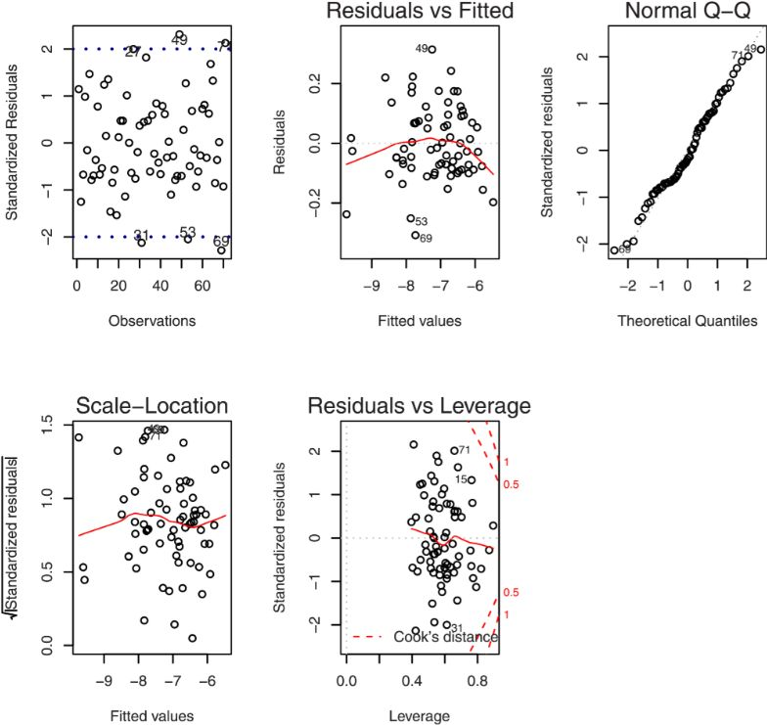
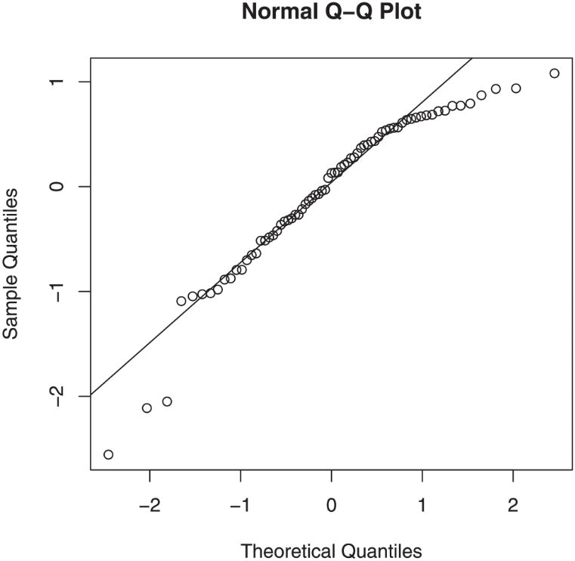
Fig 1. Diagnostic plots for the riboflavin production data set.
Fig 2. Q–Q plot based on the ridge estimator for the riboflavin production data set.

Slide 26
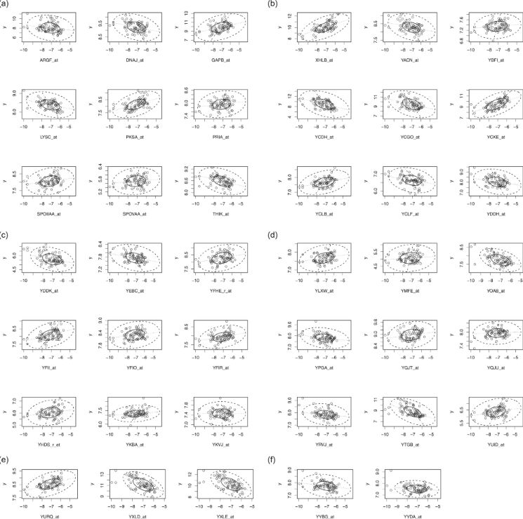
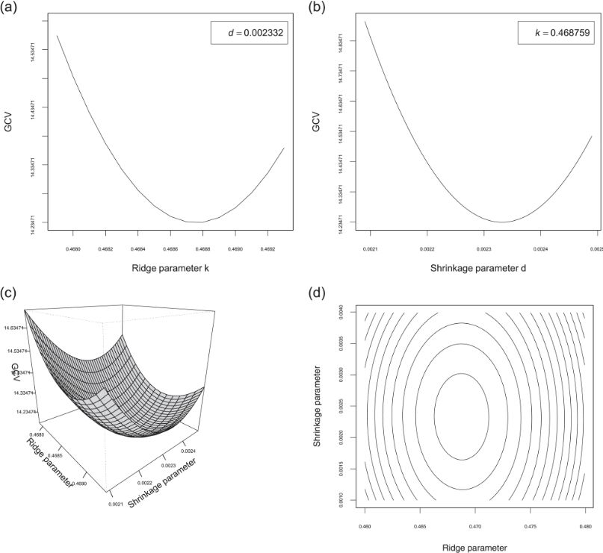
Fig 3. Bivariate boxplot of the riboflavin production data set for effective genes.
Fig 4. The diagram of and its counter plot versus k and d for the riboflavin production data set.

Slide 27
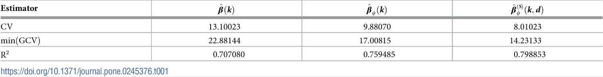
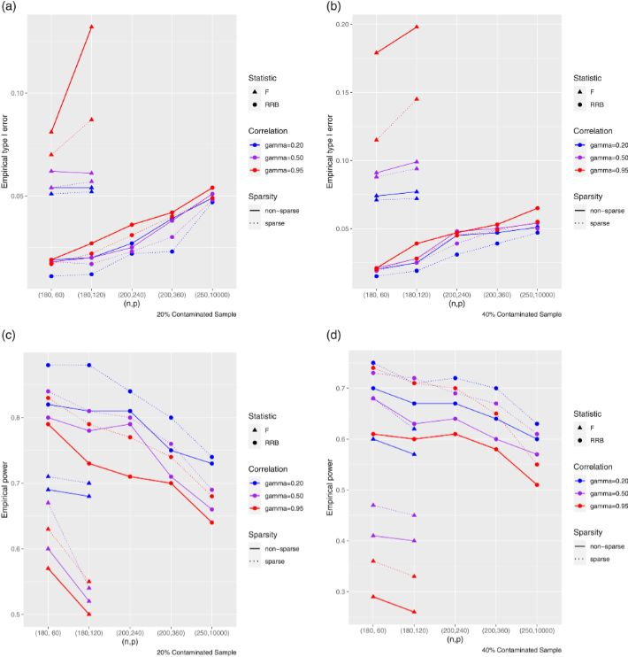
Table 1. Evaluation of proposed estimators for the riboflavin production data set.
Fig 5. The diagram of empirical type I error and power for different (n, p) for the simulated data sets.

Slide 28
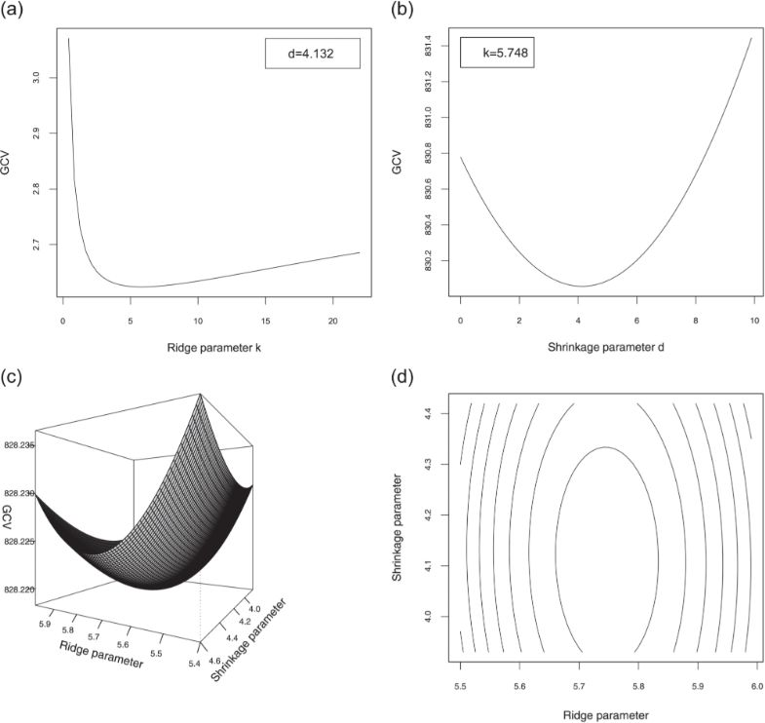
Fig 6. The diagram of GCV and its counter plot versus k and d for the simulated data set.

Slide 29
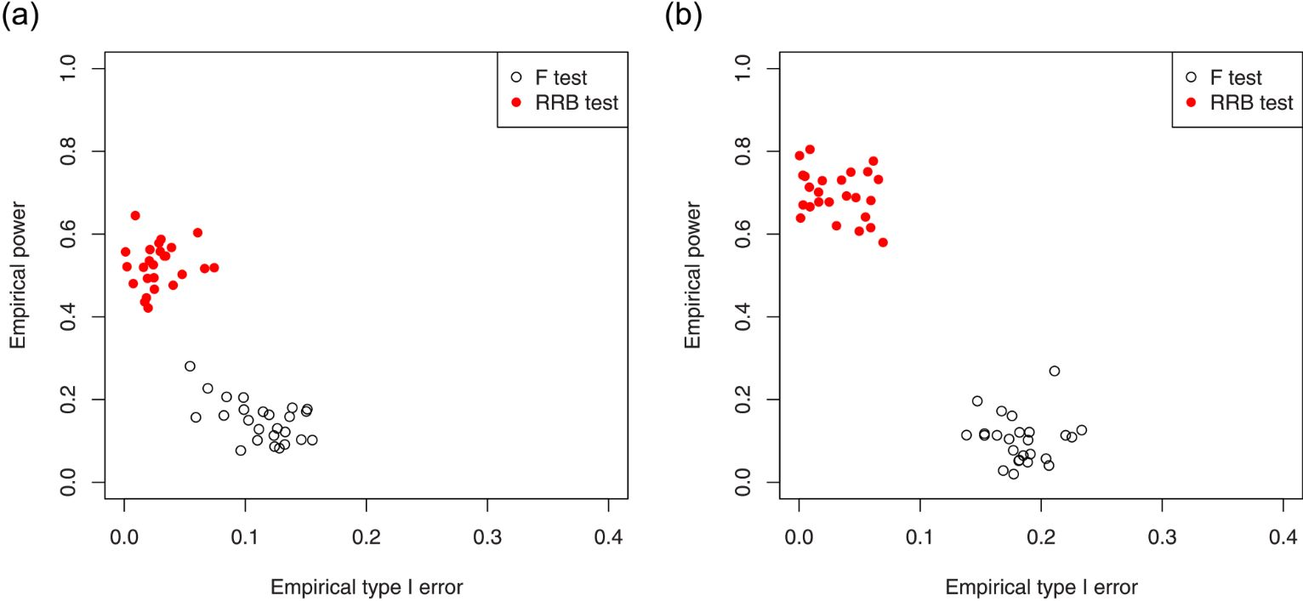
Fig 7. Comparison between F test and RRB test for the non-sparse case (left diagram) and sparse case (right diagram) with γ = 0.95, n = 180, p = 120 and CS = 40%.

Slide 30

Efficient Prediction of Cardiovascular Disease Using Machine Learning Algorithms With Relief and LASSO Feature Selection Techniques
Ghosh, P., Azam, S., Jonkman, M., Karim, A., Shamrat, F. M. J. M., Ignatious, E., Shultana, S., Beeravolu, A. R., Boer, F. D. (2021)
Notes:
Published by Institute of Electrical and Electronics Engineers or IEEE, conducted by Pronab Ghosh et. Al, the researchers developed a predictive model that utilizes relief and Lasso feature selection techniques to accurately predict Cardiovascular Heart Disease. The researchers implemented effective data collection, data pre-processing, data transformation techniques, and used 5 combined datasets to generate accurate information for the model. The researchers proudly concluded that they produced the highest accuracy while using Random Forest Bagging Method or RFBM and relief feature selection methods with a 99.05% accuracy.
The following slides are the research methodology used by the researchers.

Slide 31
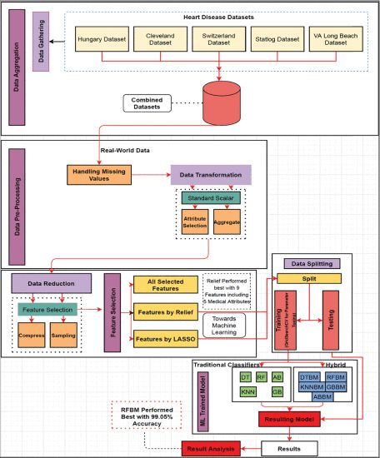
FIGURE 1. Working diagram of proposed model.
Notes:
Overview of the proposed model where the dataset is constructed by combining 5 different datasets from hungary, Cleveland, Switzerland, statlog, and VA long beach. Then the data is analyzed for any missing values by using K-Nearest Neighbors imputation technique, in which replaces missing values by finding the most similar data points and averaging their values. Then they used relief and lasso regression to overcome overfitting and avoid long execution times. After feature selection, the 80% of the data is sent into training and the rest into testing. To determine which model is best for the dataset, they implemented multiple training models to determine which is best. This resulted in the RFBM producing a 99.05% accuracy.

Slide 32
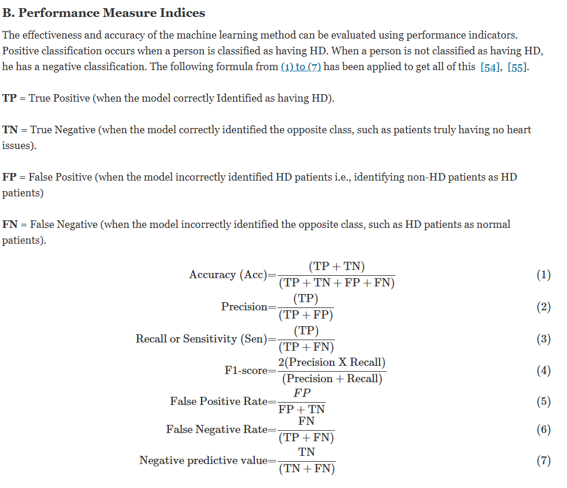
Notes:
The performance measure indicators

Slide 33
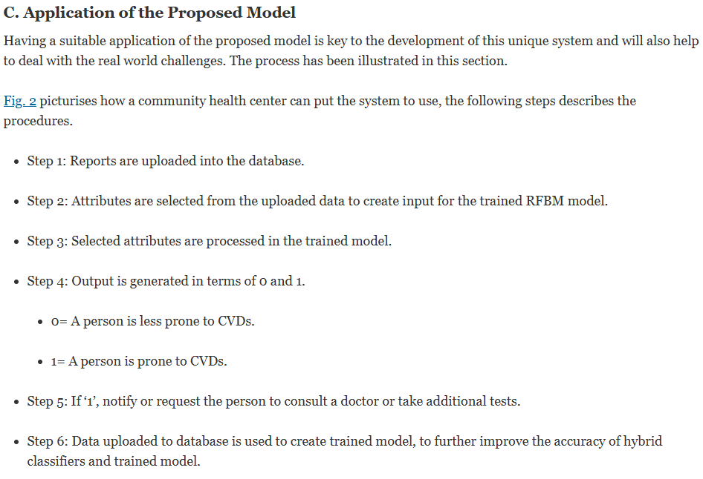
Notes:
This is the application of the proposed model wherein how the researchers plan to implement the model to assist in real world problems.

Slide 34
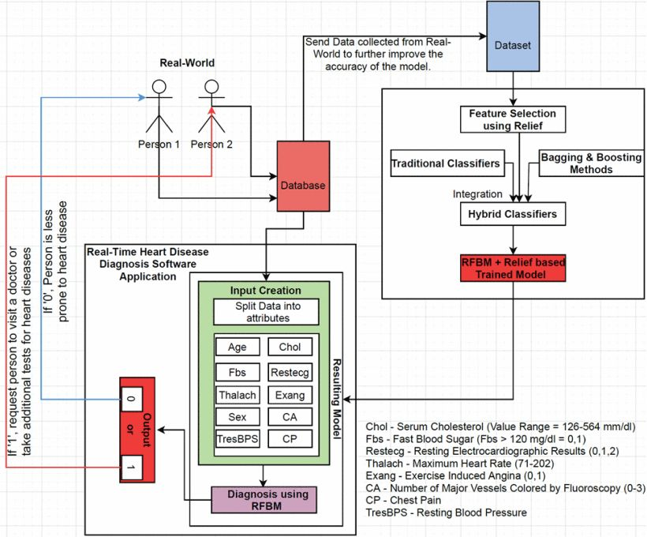
FIGURE 2. Suitable application of proposed model.

Slide 35

IN CONCLUSION,
Notes:
Before I end the discussion, what can we reflect about the topic?
Both ridge and lasso regression techniques has their own specialty and uses, while ridge can be advantageous to use in datasets with severe multicollinearity, the lasso technique can be best used to filter out the most important variables in a giving dataset and dropping other variables that are not beneficial to the training model. Both regularization techniques are important to today's world especially in machine learning to develop an accurate prediction model that stays accurate even if it’s given a different dataset is to train itself and produce a requested prediction.
That is all

Slide 36





THANK YOU FOR NOT LISTENING!
Notes:
That is all, thank you for listening to my presentation on topic 4: Regularization: Ridge vs Lasso.

Slide 37

References:
****
1. Arashi, M., Roozbeh, M., Hamzah, N. A., & Gasparini, M. (2021). Ridge regression and its applications in genetic studies. PLoS ONE, 16(4), e0245376. https://doi.org/10.1371/journal.pone.0245376
2. Efficient prediction of cardiovascular disease using machine learning algorithms with Relief and LASSO feature selection techniques. (2021). IEEE Journals & Magazine | IEEE Xplore. https://ieeexplore.ieee.org/abstract/document/9333574
3. Ibm. (2025, July 9). Lasso Regression. What is lasso regression? https://www.ibm.com/think/topics/lasso-regression
4. Murel, J., PhD, & Kavlakoglu, E. (2025, July 22). Ridge Regression. What is ridge regression?
https://www.ibm.com/think/topics/ridge-regression
Notes:
And these are the references that I used to develop this presentation.

